Slide 1
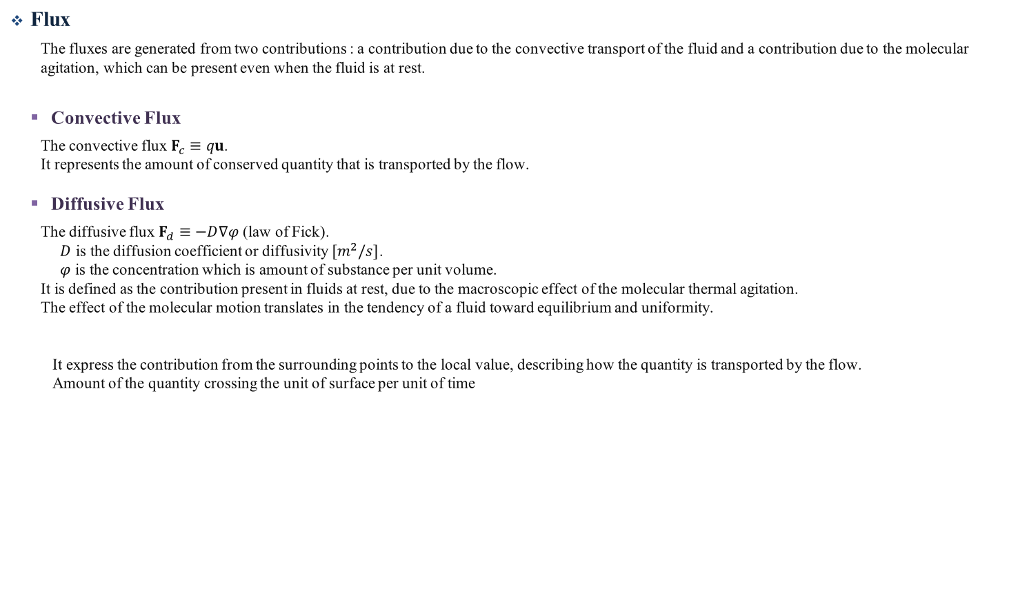
Flux
Flux
The fluxes are generated from two contributions : a contribution due to the convective transport of the fluid and a contribution due to the molecular agitation, which can be present even when the fluid is at rest.
Convective Flux
The convective flux $F_{c}≡qu$.
It represents the amount of conserved quantity that is transported by the flow.
Diffusive Flux
The diffusive flux $F_{d}≡−D∇φ$ (law of Fick).
$D$ is the diffusion coefficient or diffusivity $[m^{2}/s]$.
$φ$ is the concentration which is amount of substance per unit volume.
It is defined as the contribution present in fluids at rest, due to the macroscopic effect of the molecular thermal agitation.
The effect of the molecular motion translates in the tendency of a fluid toward equilibrium and uniformity.
It express the contribution from the surrounding points to the local value, describing how the quantity is transported by the flow.
Amount of the quantity crossing the unit of surface per unit of time

